Slide 1

2. Layouts, Views, Buttons
Andrei Deryushev
安德鲁

Slide 2
Measurement units
Pixel (px):- It is used to compare the actual pixel of the screen.
Inches (in):- It is based on the physical size of the screen 1in=2.45cm.
Millimeters (mm):- It is based on the physical size of the screen.
Points (pt):- 1/72 inch is based on the physical size of the screen.
Density independent pixel (dp) or (dip):- It is the abstract unit which is based on the physical size of the screen. The relative unit of the screen is 160 dpi. 1 dp = 1 pixel on 160 dpi screen.
Scale independent pixel (sp):-This unit is used to define font size. It is like a dp unit but it is a alternative for the user to use as a scaled for the font size.

Slide 3
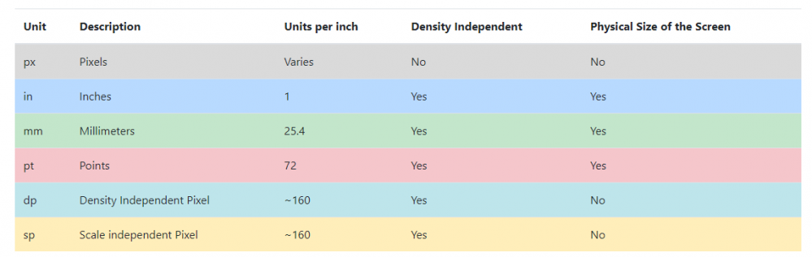
Measurement units

Slide 4
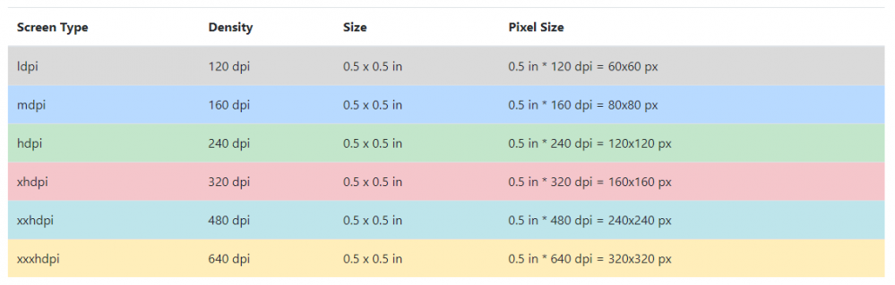
Measurement units

Slide 5
Layout
Layout is a view group that contains other Views.
Layout may be:
LinearLayout
FrameLayout
TableLayout
RelativeLayout
GridLayout
ConstraintLayout

Slide 6
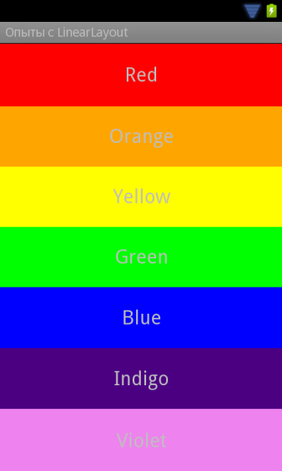
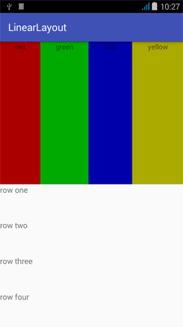
LinearLayout

Slide 7
LinearLayout
android:orientation="horizontal"
android:orientation="vertical"

Slide 8
LinearLayout: Properties
orientation – horizontal or vertical.
layout_width (match_parent, wrap_content)
layout_heigh.

Slide 9
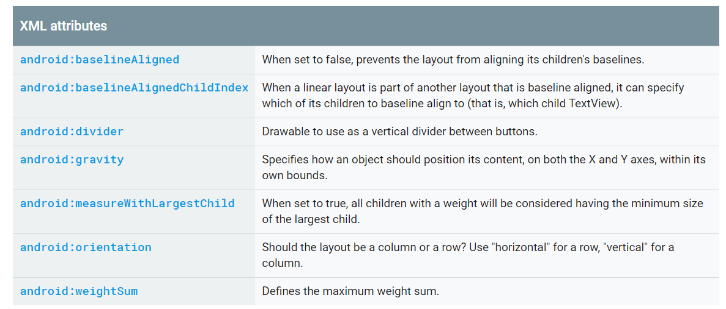
LinearLayout: Properties

Slide 10
RelativeLayout
A Layout where the positions of the children can be described in relation to each other or to the parent.
Note that you cannot have a circular dependency between the size of the RelativeLayout and the position of its children. For example, you cannot have a RelativeLayout whose height is set to WRAP_CONTENT and a child set to ALIGN_PARENT_BOTTOM.

Slide 11
RelativeLayout
android:layout_alignParentBottom
android:layout_alignParentLeft
android:layout_alignParentRight
android:layout_alignParentTop
android:layout_centerInParent
android:layout_centerHorizontal
android:layout_centerVertical

Slide 12
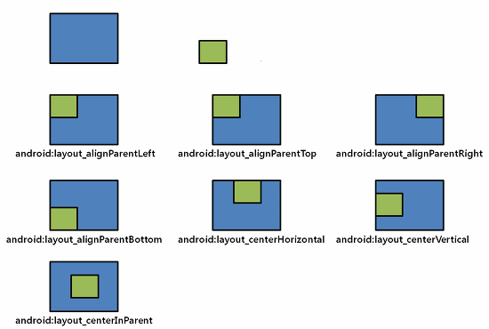
RelativeLayout

Slide 13
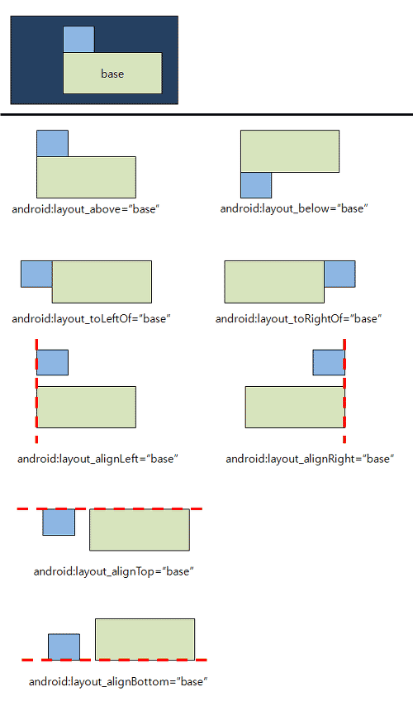
RelativeLayout

Slide 14
RelativeLayout: Margins
android:layout_marginTop
android:layout_marginBottom
android:layout_marginLeft
android:layout_marginRight

Slide 15
TableLayout
A layout that arranges its children into rows and columns. Each row has zero or more cells; each cell can hold one View object. The table has as many columns as the row with the most cells. A table can leave cells empty. Cells can span columns, as they can in HTML.
The width of a column is defined by the row with the widest cell in that column. However, a TableLayout can specify certain columns as shrinkable or stretchable by calling setColumnShrinkable() or setColumnStretchable(). If marked as shrinkable, the column width can be shrunk to fit the table into its parent object. If marked as stretchable, it can expand in width to fit any extra space. The total width of the table is defined by its parent container. It is important to remember that a column can be both shrinkable and stretchable. In such a situation, the column will change its size to always use up the available space, but never more. Finally, you can hide a column by calling setColumnCollapsed().
The children of a TableLayout cannot specify the layout_width attribute. Width is always MATCH_PARENT. However, the layout_height attribute can be defined by a child; default value is ViewGroup.LayoutParams.WRAP_CONTENT. If the child is a TableRow, then the height is always ViewGroup.LayoutParams.WRAP_CONTENT.

Slide 16
TableLayout
Cells must be added to a row in increasing column order, both in code and XML. Column numbers are zero-based. If you don't specify a column number for a child cell, it will autoincrement to the next available column. If you skip a column number, it will be considered an empty cell in that row. See the TableLayout examples in ApiDemos for examples of creating tables in XML.
Although the typical child of a TableLayout is a TableRow, you can actually use any View subclass as a direct child of TableLayout. The View will be displayed as a single row that spans all the table columns

Slide 17

TableLayout

Slide 18
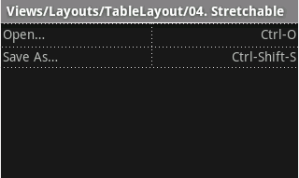
TableLayout: Example

Slide 19
GridLayout
A layout that places its children in a rectangular grid.
The grid is composed of a set of infinitely thin lines that separate the viewing area into cells. Throughout the API, grid lines are referenced by grid indices. A grid with N columns has N + 1 grid indices that run from 0 through N inclusive. Regardless of how GridLayout is configured, grid index 0 is fixed to the leading edge of the container and grid index N is fixed to its trailing edge (after padding is taken into account).
Row and Column Specs
Children occupy one or more contiguous cells, as defined by their rowSpec and columnSpec layout parameters. Each spec defines the set of rows or columns that are to be occupied; and how children should be aligned within the resulting group of cells. Although cells do not normally overlap in a GridLayout, GridLayout does not prevent children being defined to occupy the same cell or group of cells. In this case however, there is no guarantee that children will not themselves overlap after the layout operation completes.
Default Cell Assignment
If a child does not specify the row and column indices of the cell it wishes to occupy, GridLayout assigns cell locations automatically using its: orientation, rowCount and columnCount properties.

Slide 20
FrameLayout
FrameLayout is designed to block out an area on the screen to display a single item. Generally, FrameLayout should be used to hold a single child view, because it can be difficult to organize child views in a way that's scalable to different screen sizes without the children overlapping each other.

Slide 21
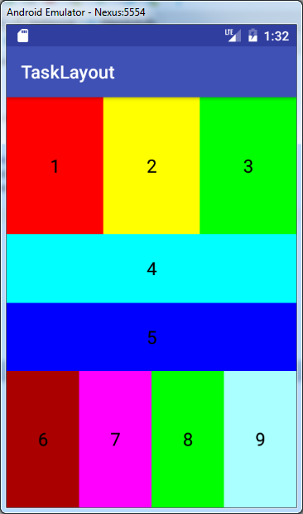
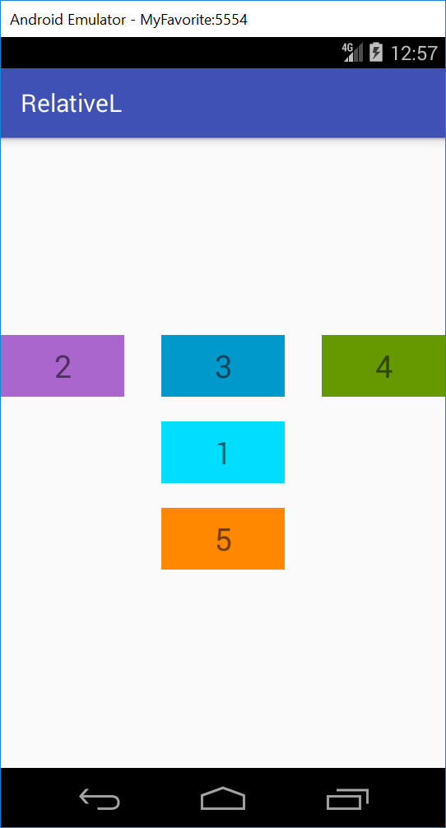
Home Task

Slide 22
ConstraintLayout
ConstraintLayout allows you to create large and complex layouts with a flat view hierarchy (no nested view groups). It's similar to RelativeLayout in that all views are laid out according to relationships between sibling views and the parent layout, but it's more flexible than RelativeLayout and easier to use with Android Studio's Layout Editor.
To define a view's position in ConstraintLayout, you must add at least one horizontal and one vertical constraint for the view. Each constraint represents a connection or alignment to another view, the parent layout, or an invisible guideline. Each constraint defines the view's position along either the vertical or horizontal axis; so each view must have a minimum of one constraint for each axis, but often more are necessary.
When you drop a view into the Layout Editor, it stays where you leave it even if it has no constraints. However, this is only to make editing easier; if a view has no constraints when you run your layout on a device, it is drawn at position [0,0] (the top-left corner).

